Slide 1
PHoeNIx VER. 2.2
Feb 02, 2026
Advanced Molecular Detection Southeast Region Bioinformatics

Slide 2
This resource was made possible through funding provided under the Epidemiology and Laboratory Capacity for Prevention and Control of Emerging Infectious Diseases (ELC) Cooperative Agreement (CK24-0002), Project D: Advanced Molecular Detection to the Florida Department of Health. The conclusions, findings, and opinions expressed by authors do not necessarily reflect the official position of the U.S. Department of Health and Human Services, the Public Health Service, or the Centers for Disease Control and Prevention.

Slide 3

Overview
Overview
CDC developed Nextflow pipeline for analyzing bacterial genomes with a focus on AMR. PHoeNIx v2.2 makes the pipeline easier to run, lets you update results without re-running everything, improves how Shigella is identified, cleans up summary files, and fixes resume problems.
Usage
Used by public health labs and researchers to analyze bacterial genomes, understand outbreaks, track pathogen evolution, and support studies on antimicrobial resistance and treatment response.
Dependencies
FASTQC
MultiQC
Kraken2
Nextflow
Singularity

Slide 4
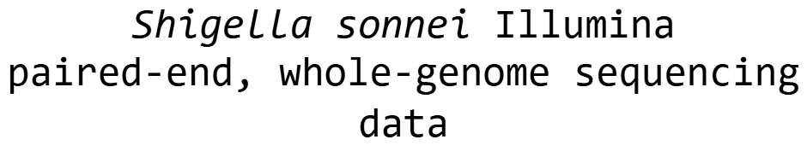
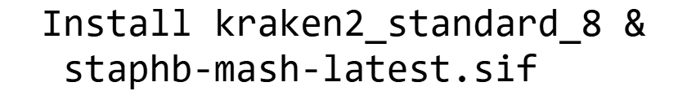








Workflow

Slide 5
Application
OBJECTIVE
Use an Shigella dataset and analyze the dataset using PHoeNIx v2.2 pipeline

Slide 6
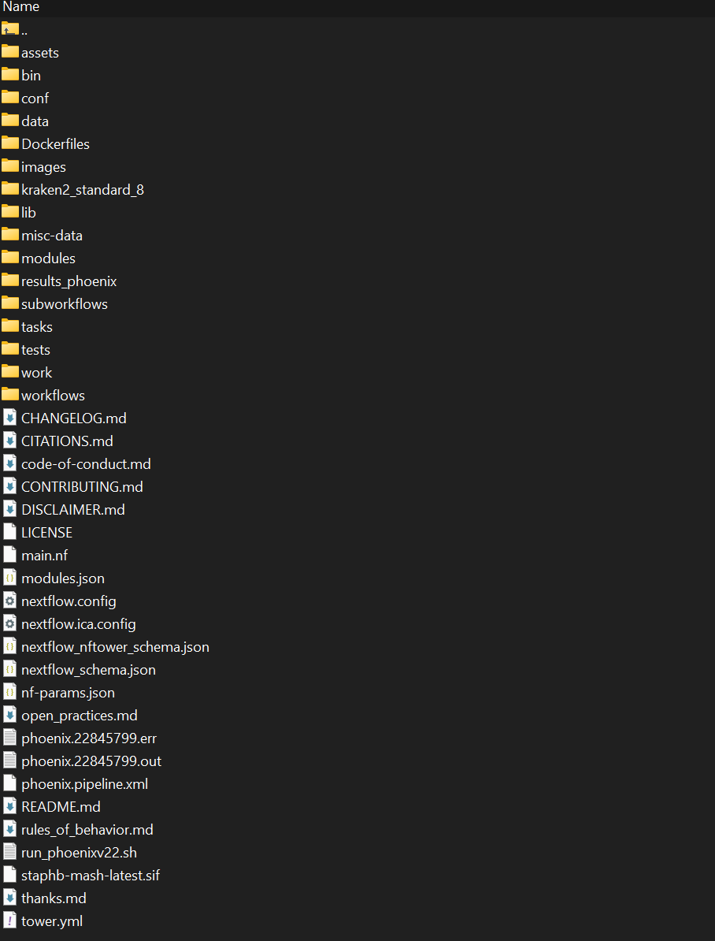
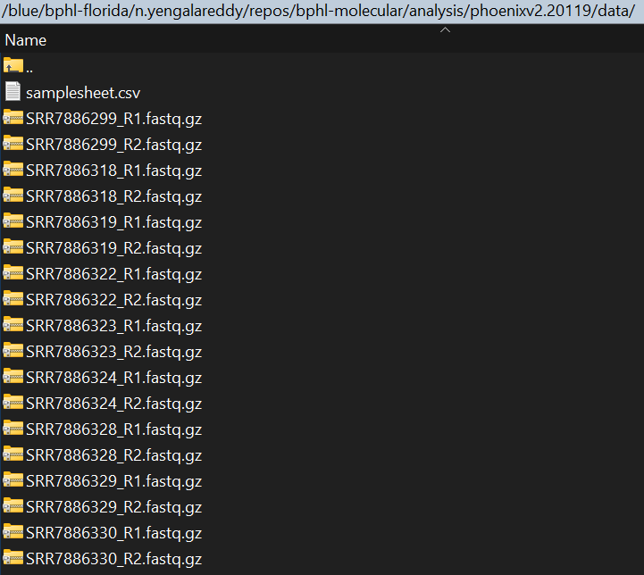
Application Cont.
cd /blue/bphl-<state>/<user>/repos/bphl-molecular/
git clone https://github.com/CDCgov/phoenix
mkdir analysis/
cd analysis/
cp /blue/bphl-<state>/<user>/repos/bphl-molecular/Phoenix/*
mkdir data/

Slide 7
Application Cont.

Slide 8
Application Cont.
cd /blue/bphl-<state>/<user>/repos/bphl-molecular/Phoenix0609/*
mkdir kraken2_standard_8/
wget https://genome-idx.s3.amazonaws.com/kraken/k2_standard_08_GB_20251015.tar.gz
tar -xvzf k2_standard_08gb_20250402.tar.gz
Delete k2_standard_08gb_20250402.tar.gz after
Check for hash.k2d, opts.k2d, and taxo.k2d files

Slide 9
Application Cont.
singularity pull staphb-mash-latest.sif docker://staphb/mash:latest

Slide 10
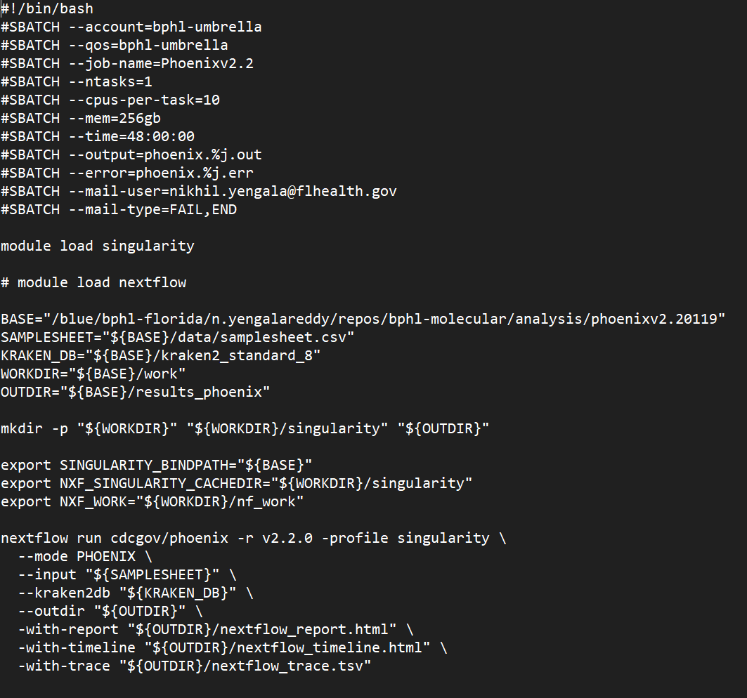
Application Cont.

Slide 11
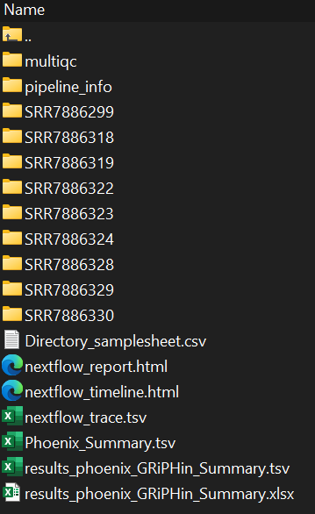
Application Cont.
sbatch run_phoenixv22.sh

Slide 12
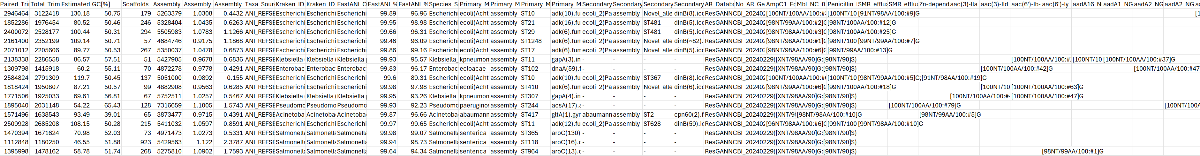
Application Cont.

Slide 13
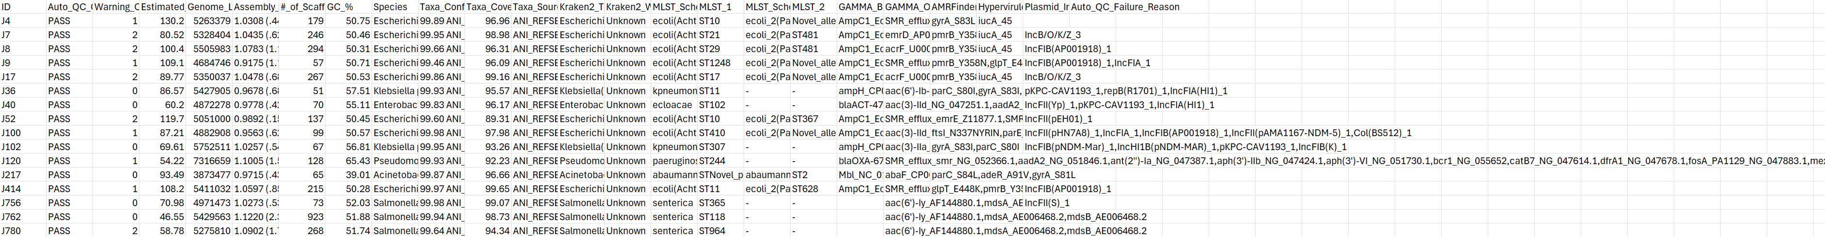
Application Cont.

Slide 14
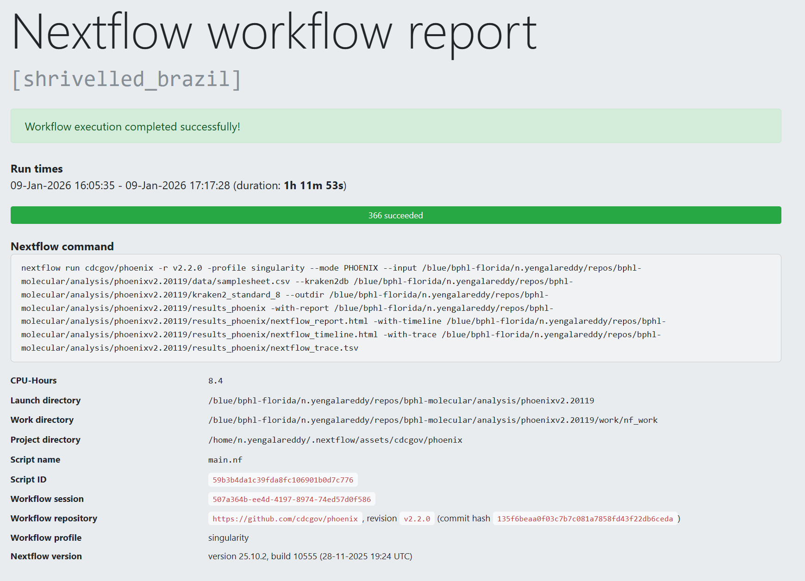
Application Cont.

Slide 15
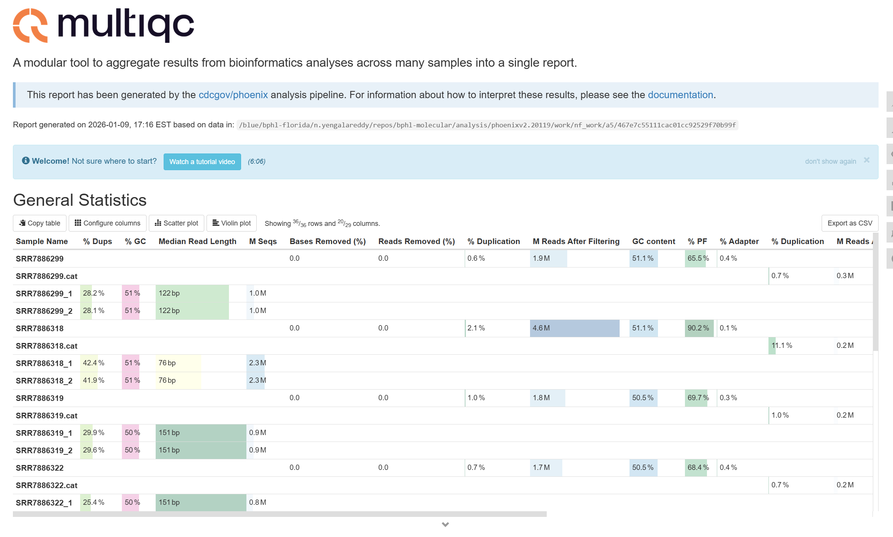
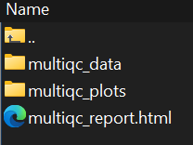
Application Cont.

Slide 16
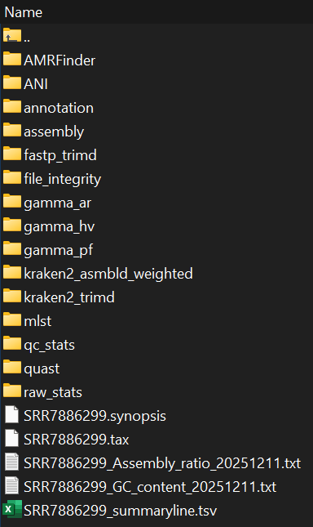
Application Cont.

Slide 17
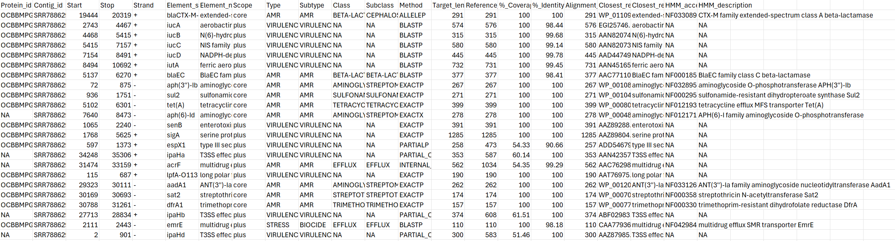
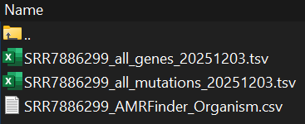
Application Cont.

Slide 18
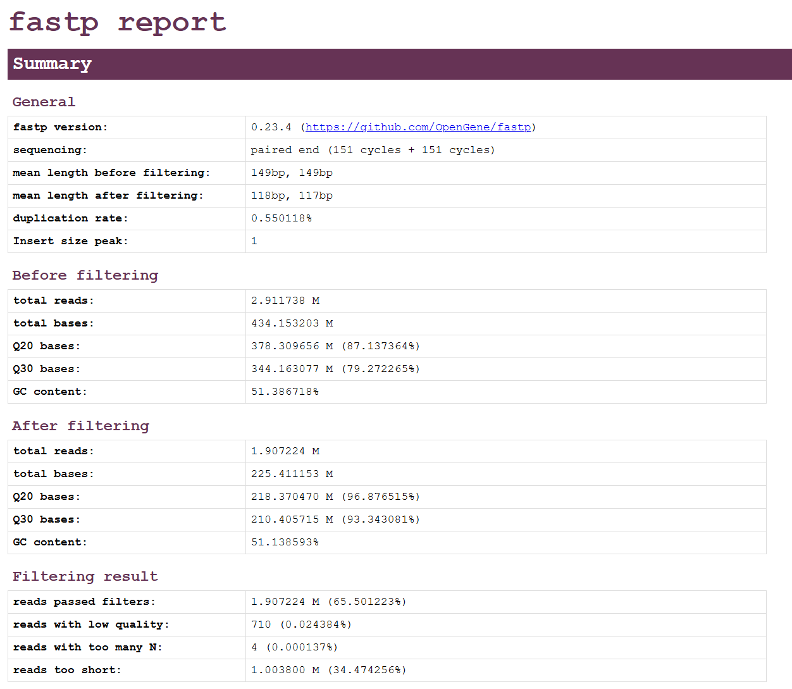
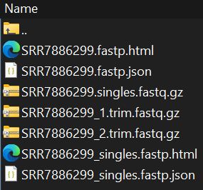
Application Cont.

Slide 19
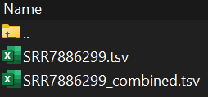
Application Cont.

Slide 20
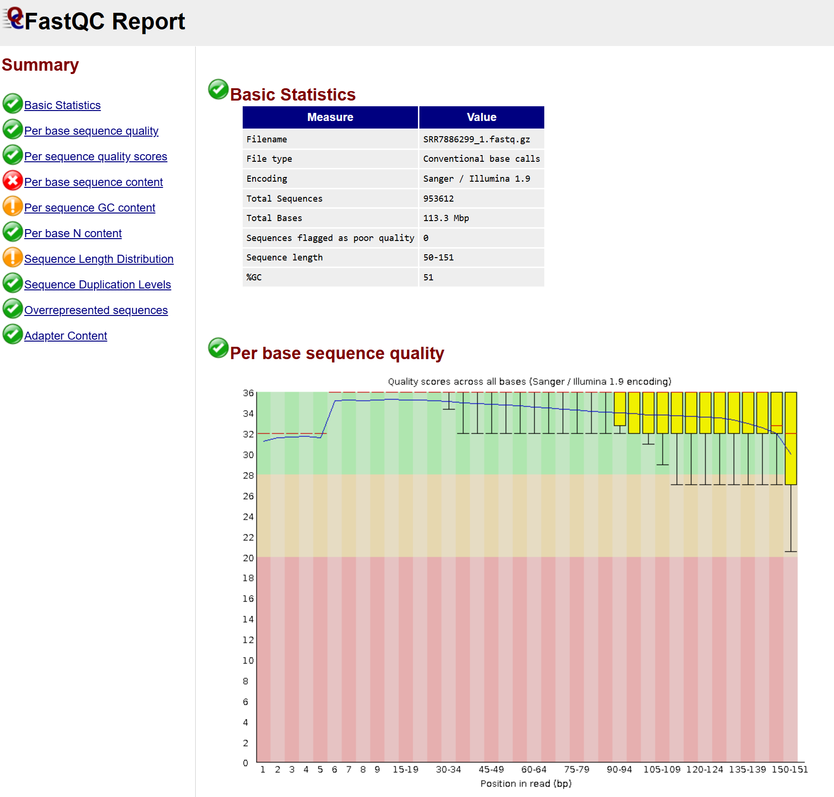
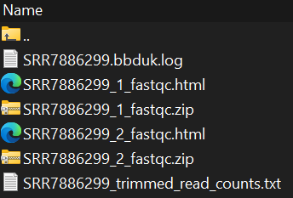
Application Cont.

Slide 21
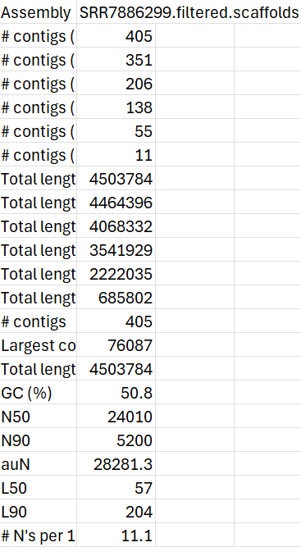

Application Cont.

Slide 22

Conclusion
Successfully executed job query for PHoeNIx
Installation and setup of PHoeNIx in HPG
Generated output files
Fundamentals of PHoeNIx

Slide 23

Questions?
bphl-sebioinformatics@flhealth.gov
Molly Mitchell, PhD
Bioinformatics Supervisor
Molly.Mitchell@flhealth.gov
Nikhil Reddy, MS
Bioinformatician
Nikhil.Yengala@flhealth.gov
Sam Bernhoft, MPH
Bioinformatician
Samantha.bernhoft@flhealth.gov

